Slide 1
Photovoltaic Systems Modelling and Predictions
Data Mining 2020
Metodija Novkovski | Risto Trajanov

Slide 2
Goal of the Project
Our goals:
Use data from photovoltaic and global forecast systems to train a model for prediction of consumption and yield of electrical energy
Client’s goals:
Optimize client’s use of his photovoltaic station and energy
Determine most efficient way of using generated energy

Slide 3
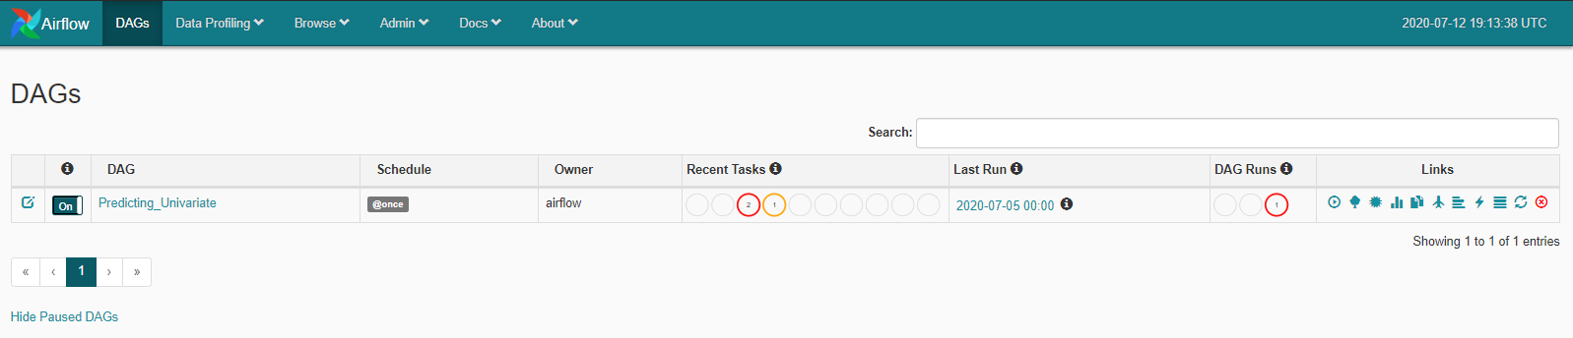
Technologies
Airflow (orchestration platform)
Postgres/TimeScaleDB (time series optimized database)
Docker (container environment)
Amazon ec2/s3 (cloud based servers and bucket storage)

Slide 4
Datasets
Local photovoltaic system with Fronius inverters (Postgres)
Consumption of energy
Testing and forecasts
SMA (sunnyportal) global photovoltaic systems (crawler for German system)
Production of energy
Weatherbit, history weather data and weather forecast for next 120h based on latitude and longitude

Slide 5
Setup
Airflow
Docker
PostgreSQL and Amazon S3 Connections

Slide 6
Extraction of data
Local Static Data from Postgres Database
Perpetual extraction of weather forecasts from Weatherbit based on lat and long through API
Time dependent
Perpetual extraction of german photovoltaic system with crawler
Time dependent

Slide 7
Transformation and Preprocessing
Read data from various sensors
Set and sort datetime index for time-series format
Hourly based aggregation
Merge data from all tables
Dealing with missing values
Dealing with outliers
Testing features for multicollinearity (Variance Inflation Factor)
For impact in regressive models

Slide 8
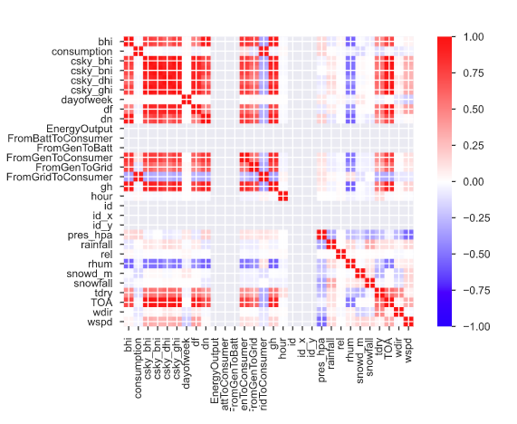
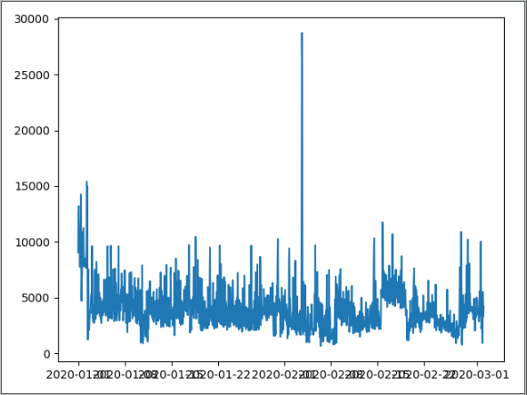
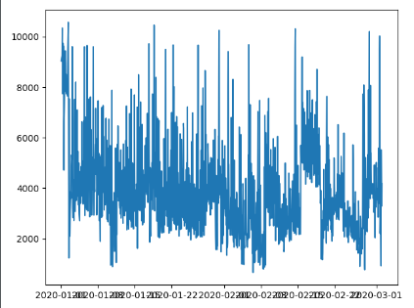
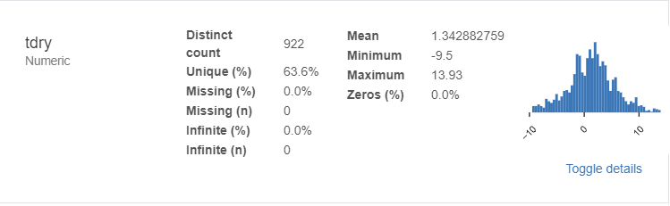
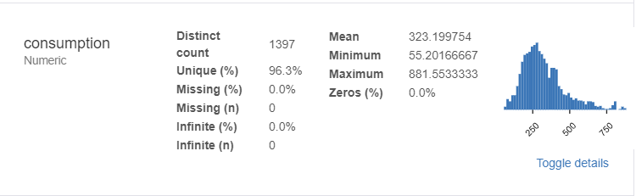
Visualization

Slide 9
Persistence
Loading data in Postgres database with Postgres Operators/Hooks
Airflow connections
SQLAlchemy
Model persistence
Pickle
Keras
Amazon S3

Slide 10
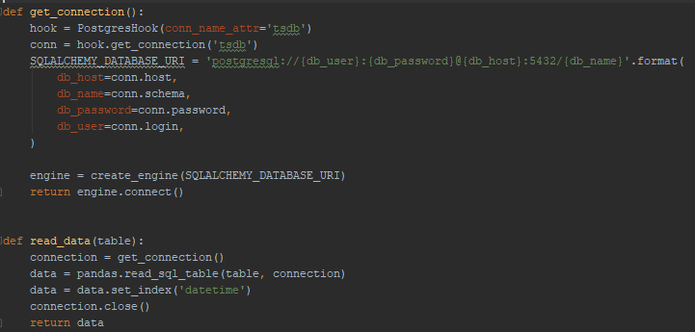
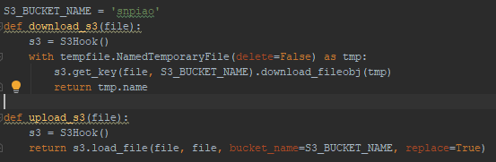

Slide 11
Models
ARIMA (AutoRegressive Integrated Moving Average)
Facebook Prophet
XGBoost Regressor
Deep Learning Models:
LSTM
Univariate
Multivariate

Slide 12
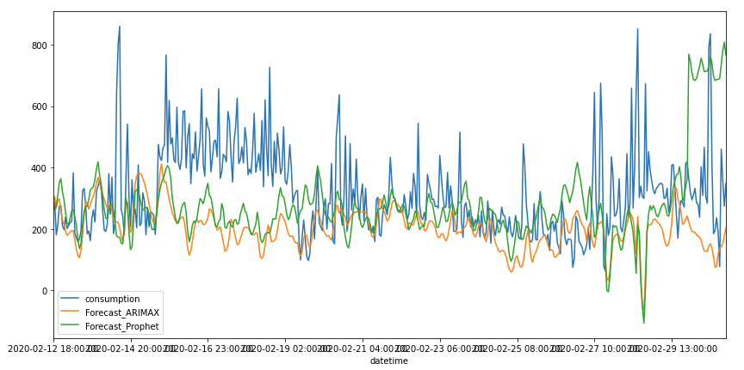
Arima & FB Prophet

Slide 13
Long Short-Term Memory RNN
Type of Recurrent Neural Network
Modeling sequence dependence in time series data.
Deep Learning / Black box model
Simple and fast performant
Generalized results
Univariate
Multivariate

Slide 14
Univariate LSTM
Training on single variable for sequence dependence with respect to time
Conversion of the target variable time series to supervised sequence
Keras - Tensorflow
Three layers
RelU activation function
Adam (fast optimizer)
MSE loss function
Parameters:
Number of features
Number of time steps

Slide 15
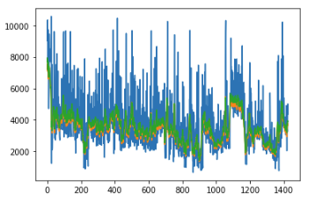
Univariate LSTM
Prior/Expert knowledge for tuning parameters
Using 24 time steps for 24 samples of the time series data aggregated to an hour of time, for 24 hours or 1 day.
Trying to learn the daily patterns induced in the data.

Slide 16
Multivariate LSTM
Modeling problems with multiple input variables
Not impacted by redundant variables
Only two layers
Low amount of epochs
Adam optimizer
MSE loss function
Still resulting with conservative and generalized predictions

Slide 17
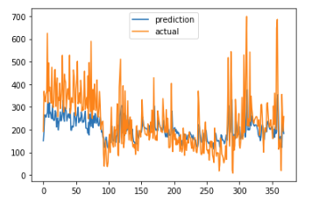
Multivariate LSTM results
Consistent and conservative results with generalized predictions
Even though it misses the high peaks, it manages to follow the general trend
We prefer this behavior such that we don’t overestimate the predictions for the clients

Slide 18
Challenges
ETL processes
Workflow problems
Airflow framework instead of cron jobs and shell scripts
Growing container sizes
Clusterize for optimization
GITHUB Repo

